Slide 1

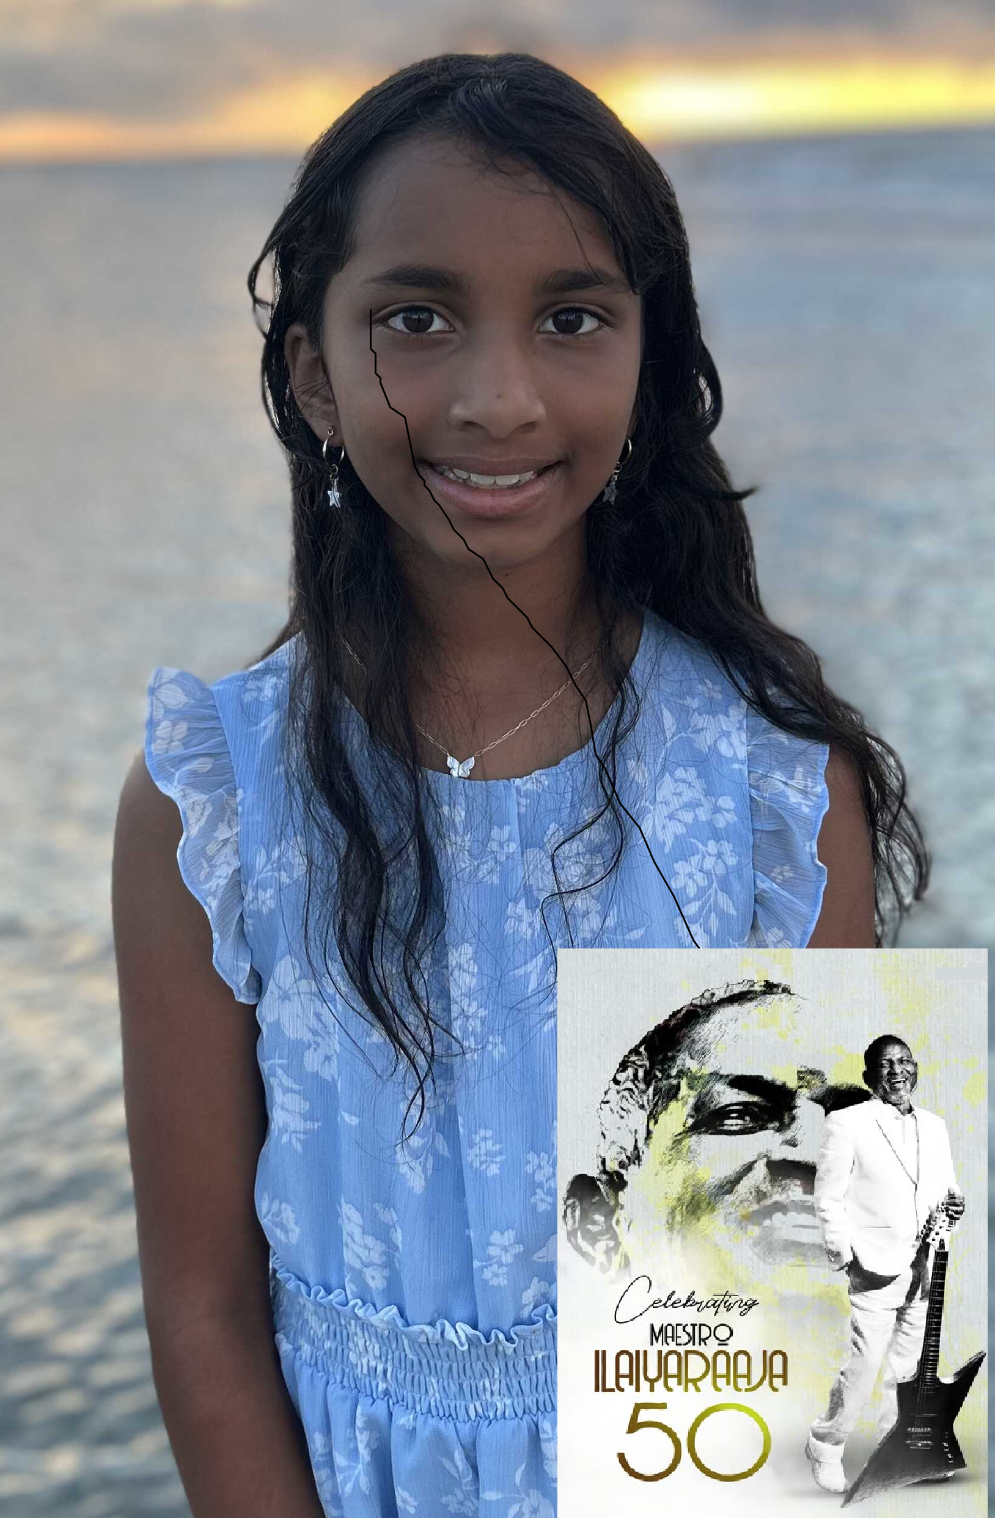
Janani Hariharan
DK41
Notes:
Image not found. ImageFile=''. Also tried from SlideName='DK41'. Searched in: ['/Users/AB74296/Downloads/DK PPT', '/Users/AB74296/Downloads/DK PPT/images', '/Users/AB74296/Downloads/DK PPT/imgs', '/Users/AB74296/Downloads/DK PPT/photos']

Slide 2
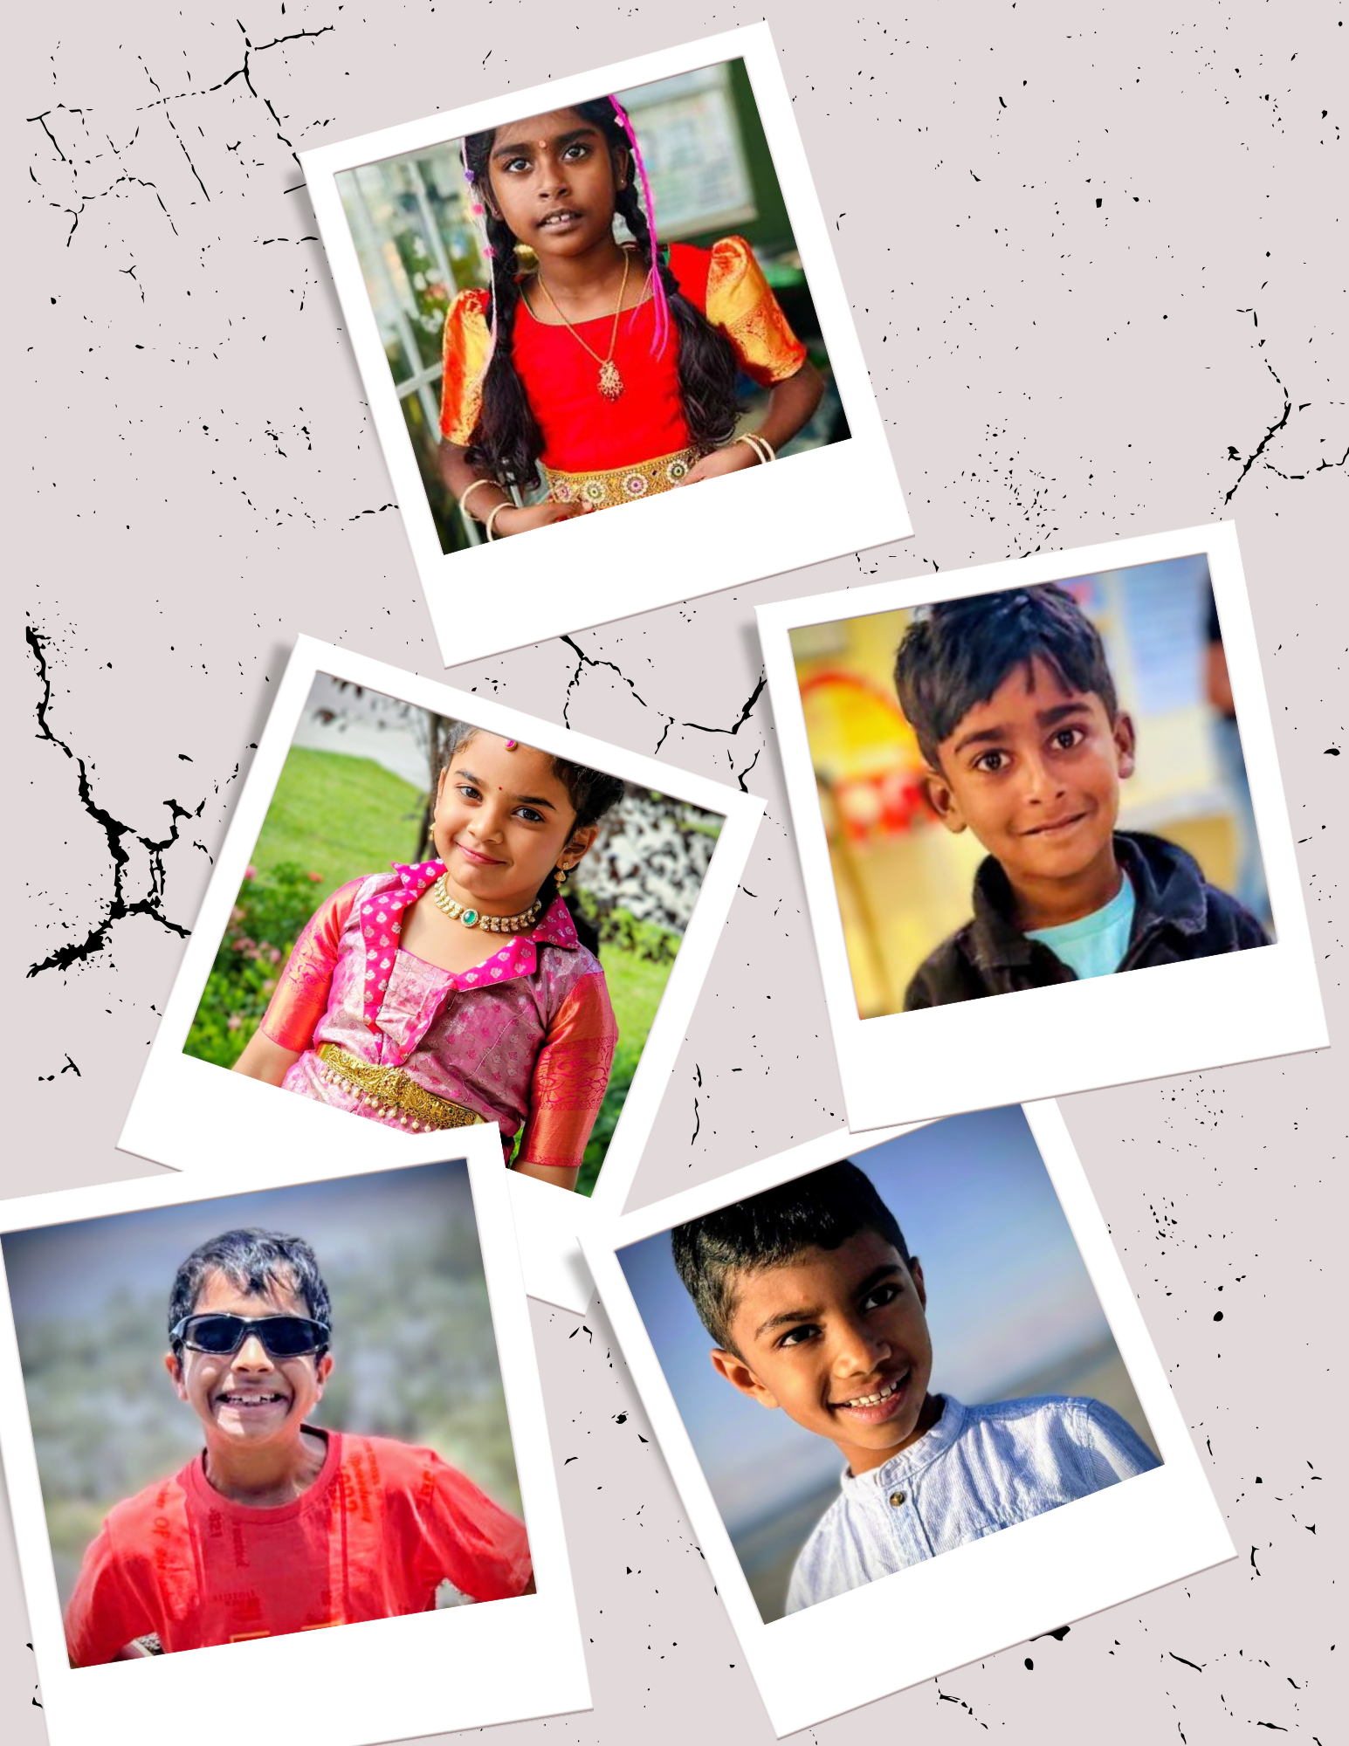
Aira Terala Akshay Arun Nayana Kotipalli
Nikhil Kotipalli Siddharth Hariharan
DK13
Notes:
Image: DK13.jpg

Slide 3
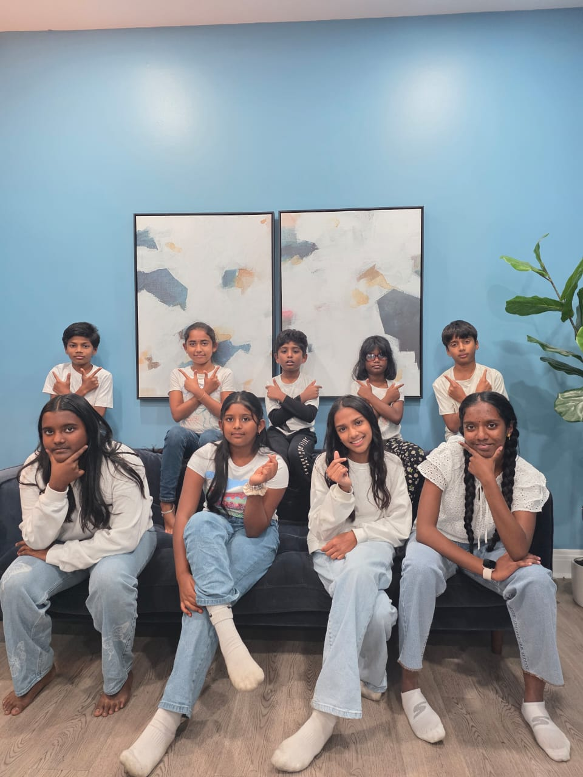
Anushree Ilayarajan Bhargav Kongara Suresh Gianna Kalidhasan Nithish Selvam Rithika Thilakkumaran
Riyaan Thilakkumaran Roshni Sivakumar Shannon Kalidhasan Shaktisri Ramachandran Suhani Rameshkumar
DK29
Notes:
Image: DK29.jpg

Slide 4
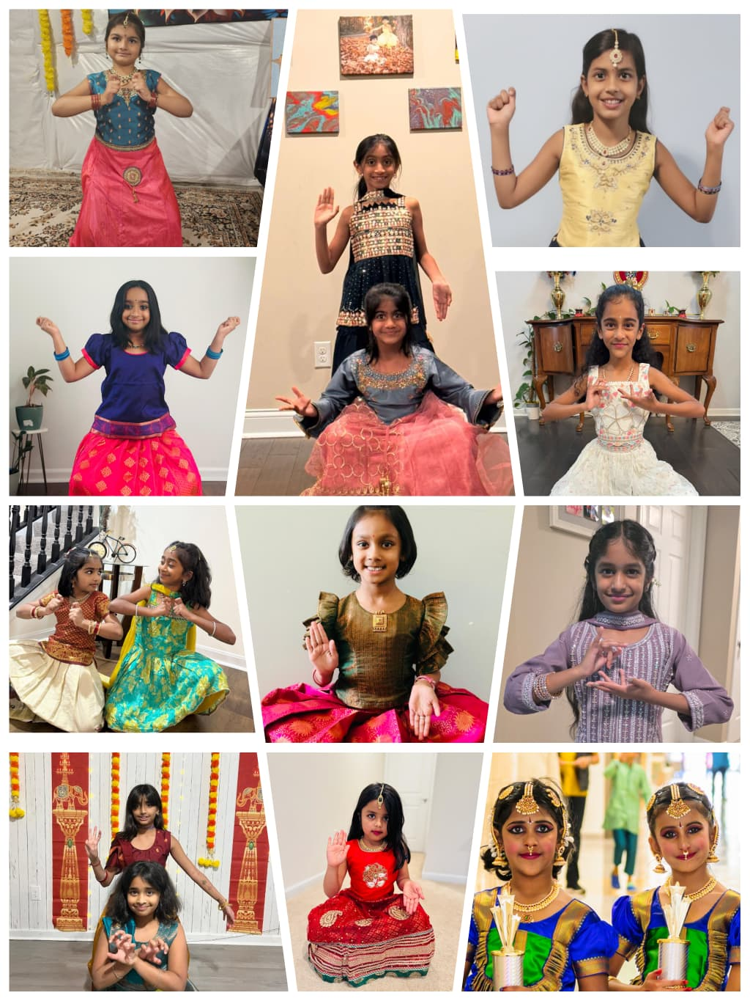
Aadhya Aneesh Aiyana Nair Akshara Divakar Ameya Aneesh Asha Byju Lakshana Shyam Naomika Nitin Nainika Bhuvanesh
Nidhi Anoop Nidhi Sathish Ria Kollambalath Saanvi Nanda Shravya Nanda Shivanya S Nair Sreshta Sanjeev
DK25
Notes:
Image: DK25.jpeg

Slide 5
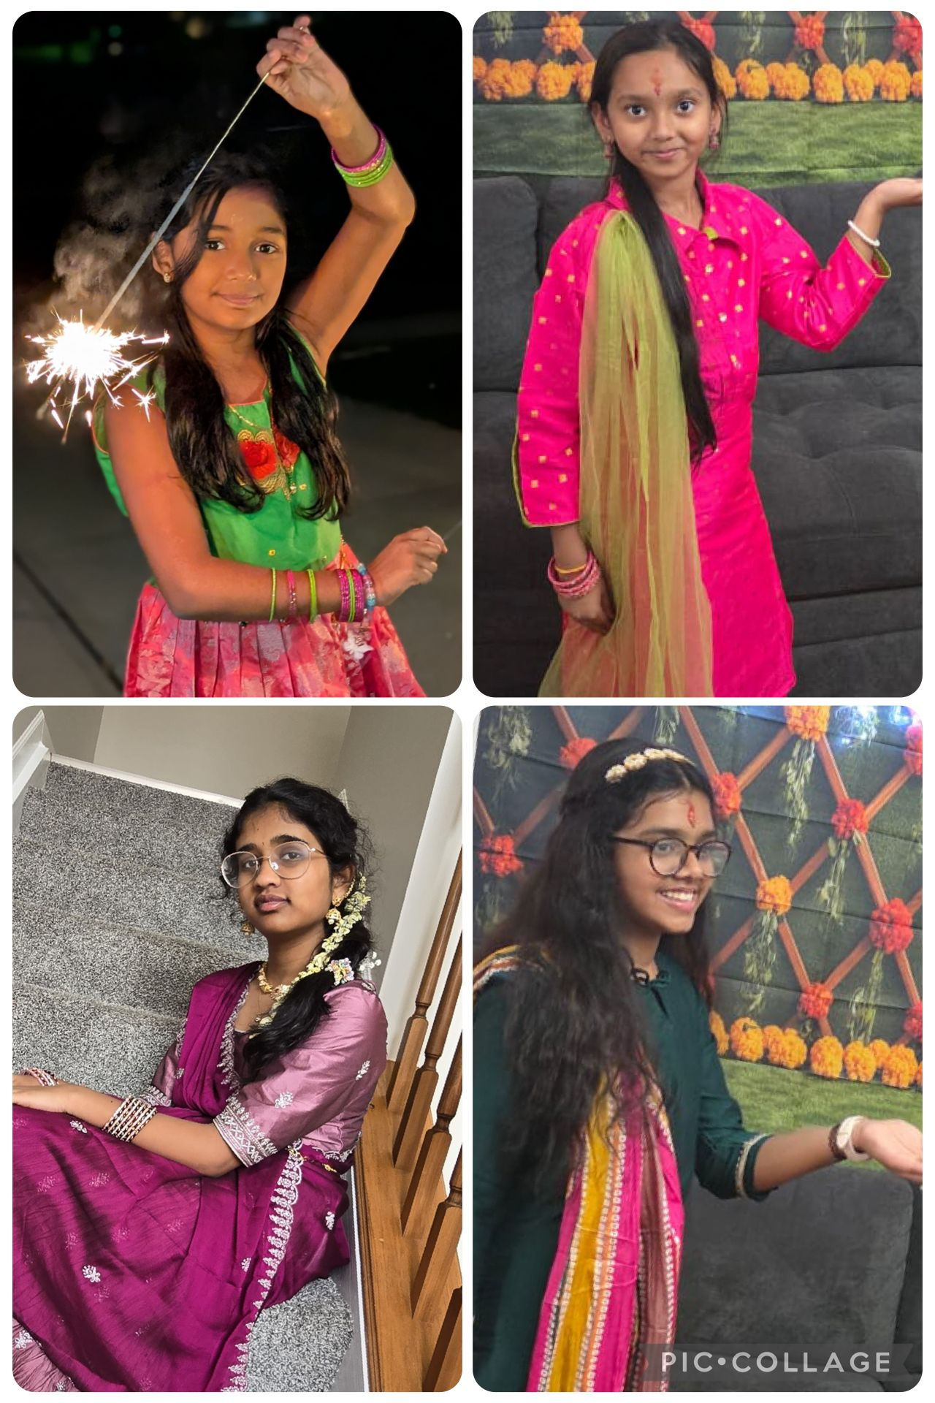
Aaradhya Dubey Arya Dubey Deekshitha Dirisinala
Moniksha Thalla Prakalya Vivek
DK22
Notes:
Image: DK22.jpg

Slide 6
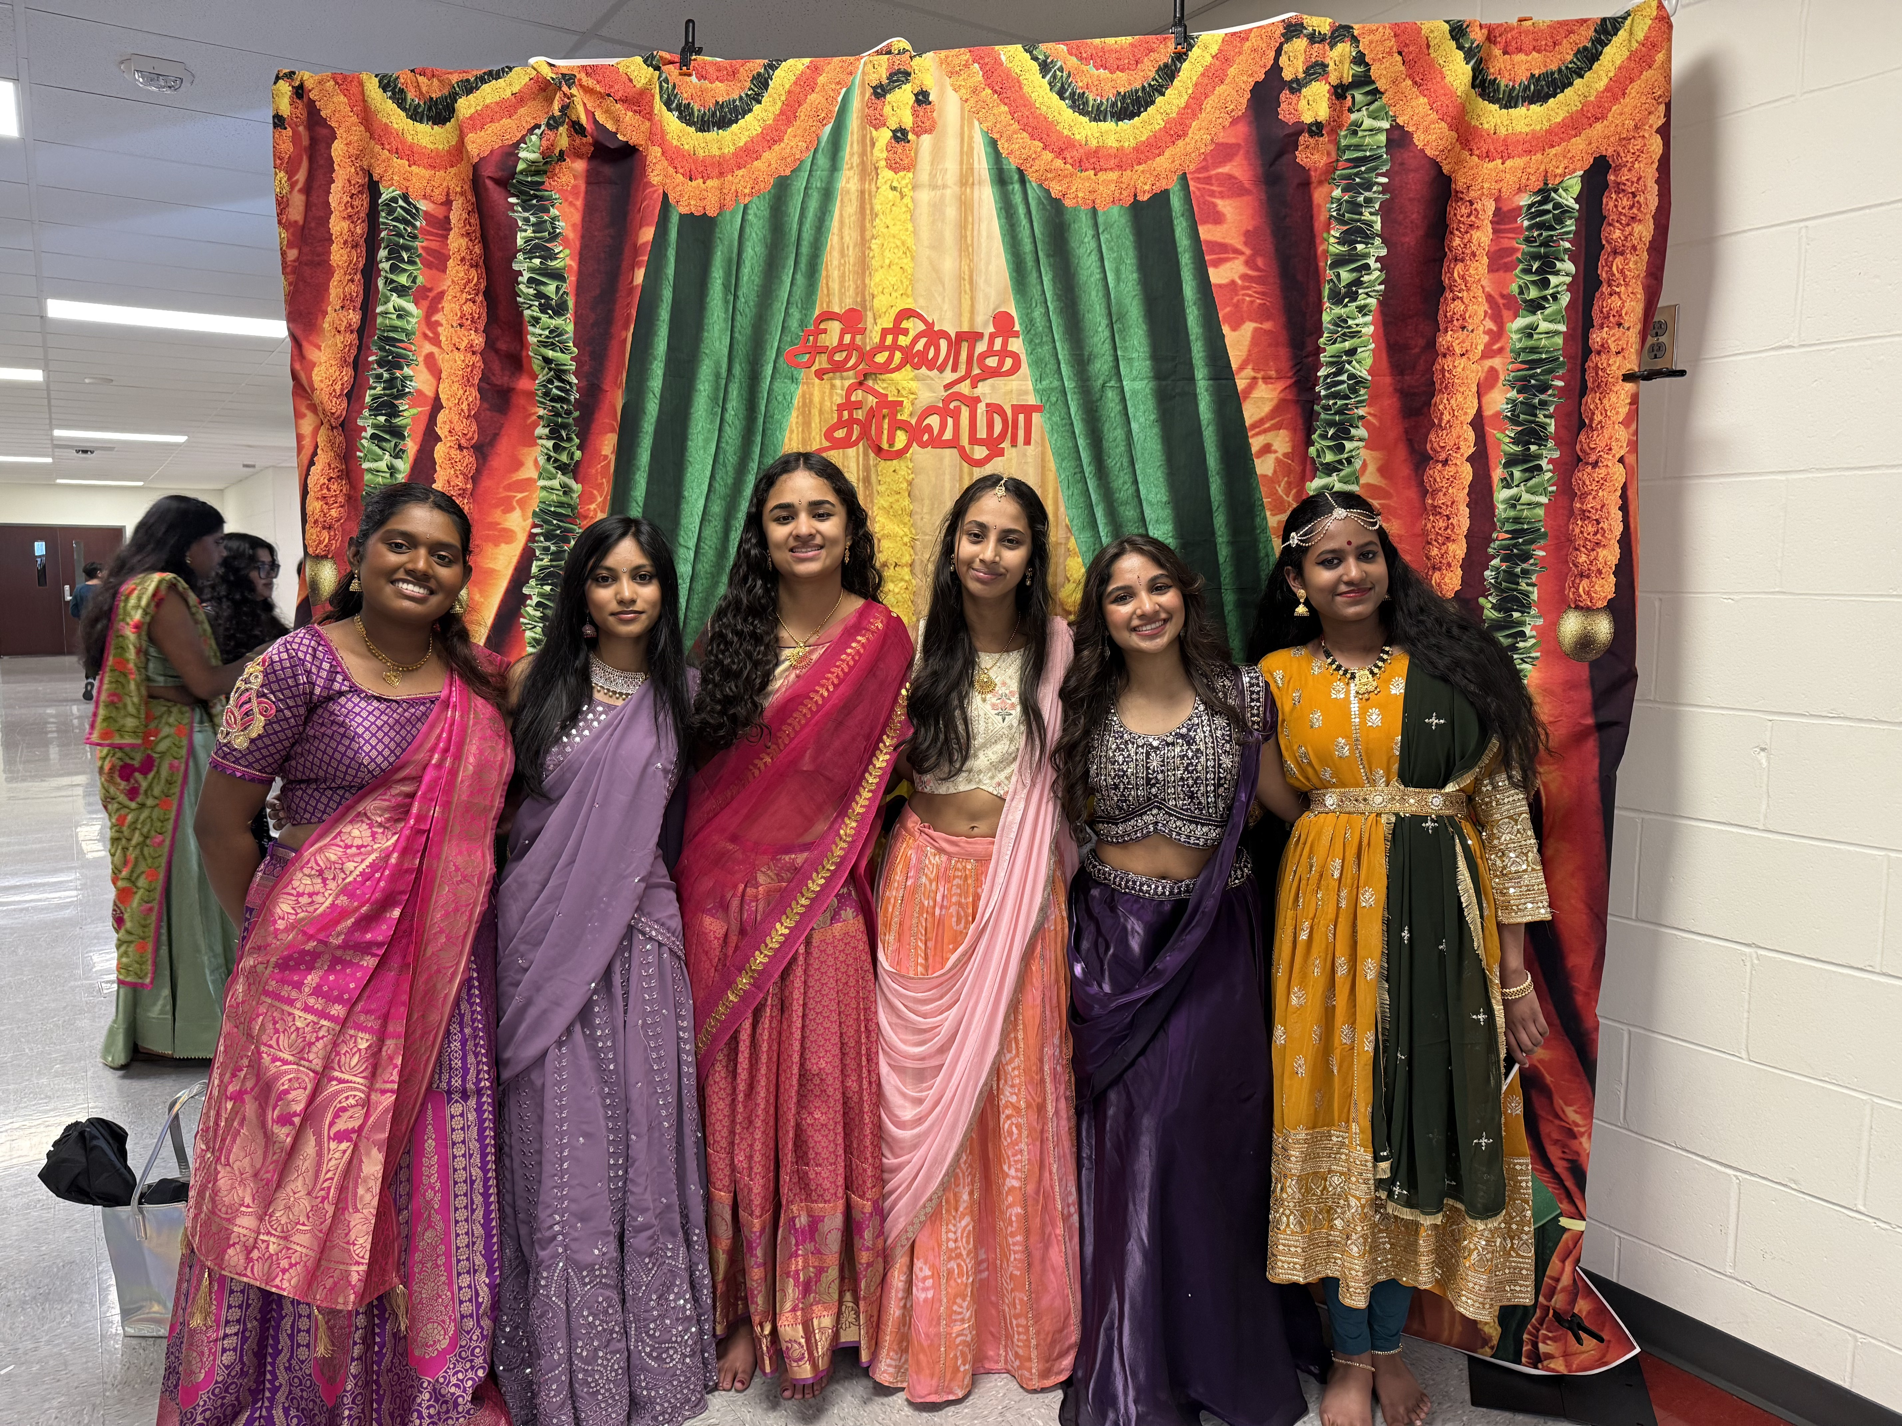
Anaya Gangam Niveditha Murthy Sanjana
Shiva Shyam Shraddha VijaySarathy Tulsi Parikh
DK37
Notes:
Image: DK37.jpg (converted)

Slide 7
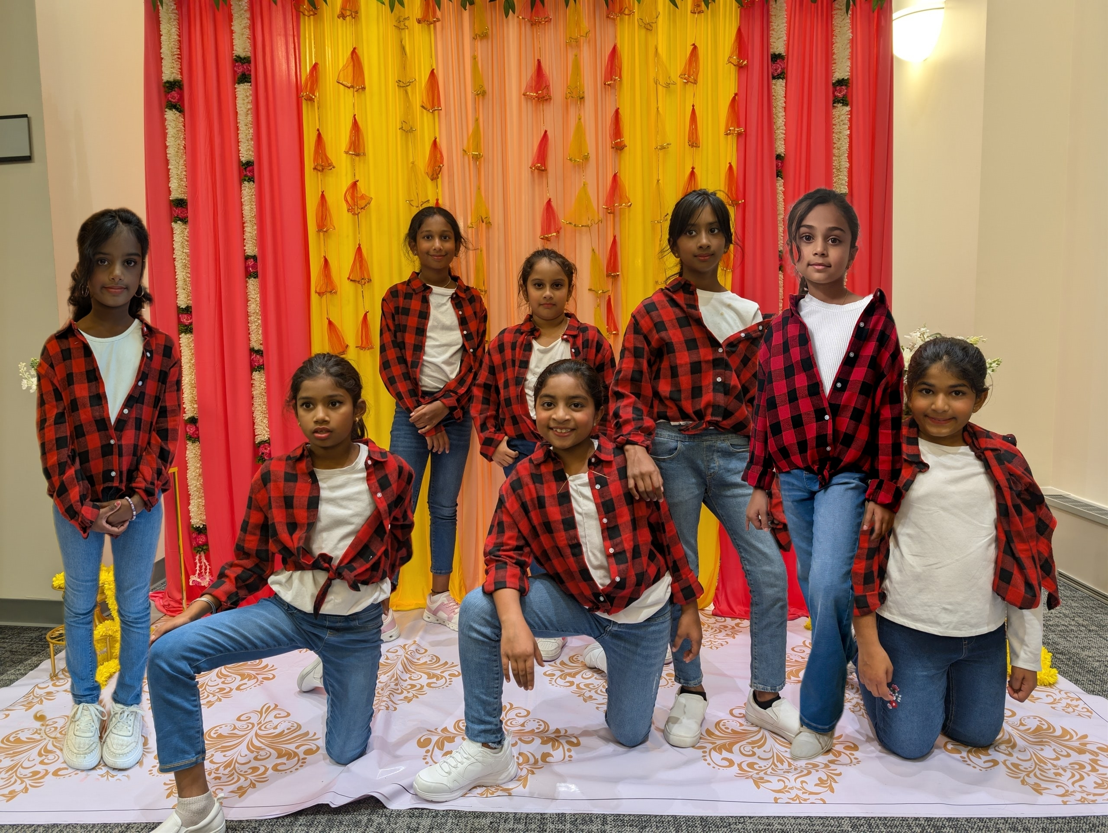
Niyantha Neelakantan Nitika Karthick Nusfia Niamath Riyas Ahamed Presha Prabhu Sai Hasini Udhaykumar
Shravya Kumar Sinamika Sivaraj Tharshika Sankaranarayanan Venba Shyam
DK34
Notes:
Image: DK34.jpg

Slide 8
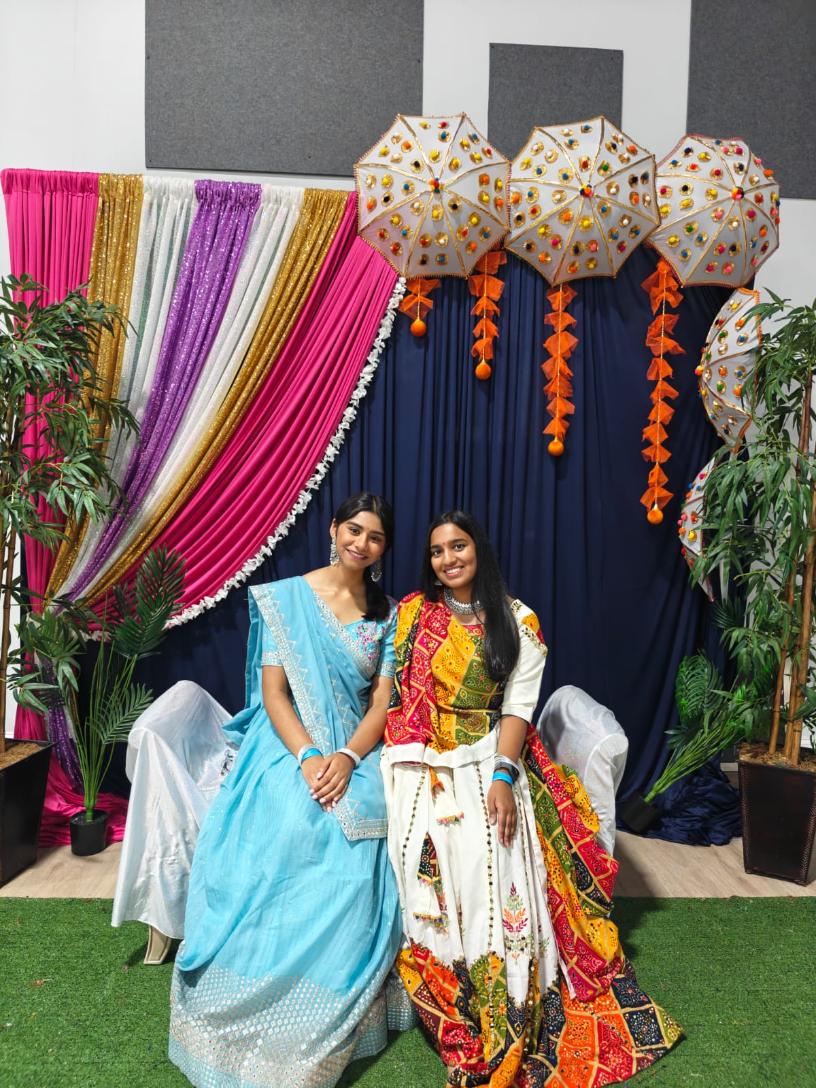
Disha Dilip
Vanessa Fernando
DK38
Notes:
Image: DK38.jpg

Slide 9
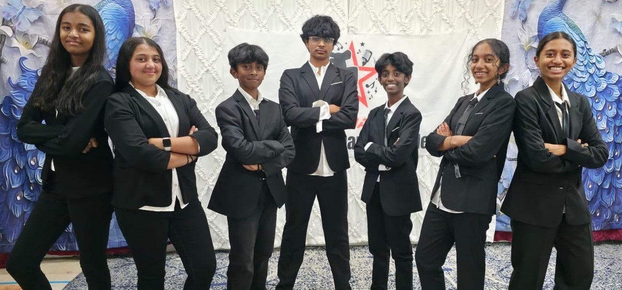
Aadya Nair Joshika Jayaprakash Kavin Senthilkumar Nainika Chetty
Saanvi Ramachandran Tarun Gopinath Vidhyuth Rajesh
DK01
Notes:
Image: DK01.jpeg

Slide 10
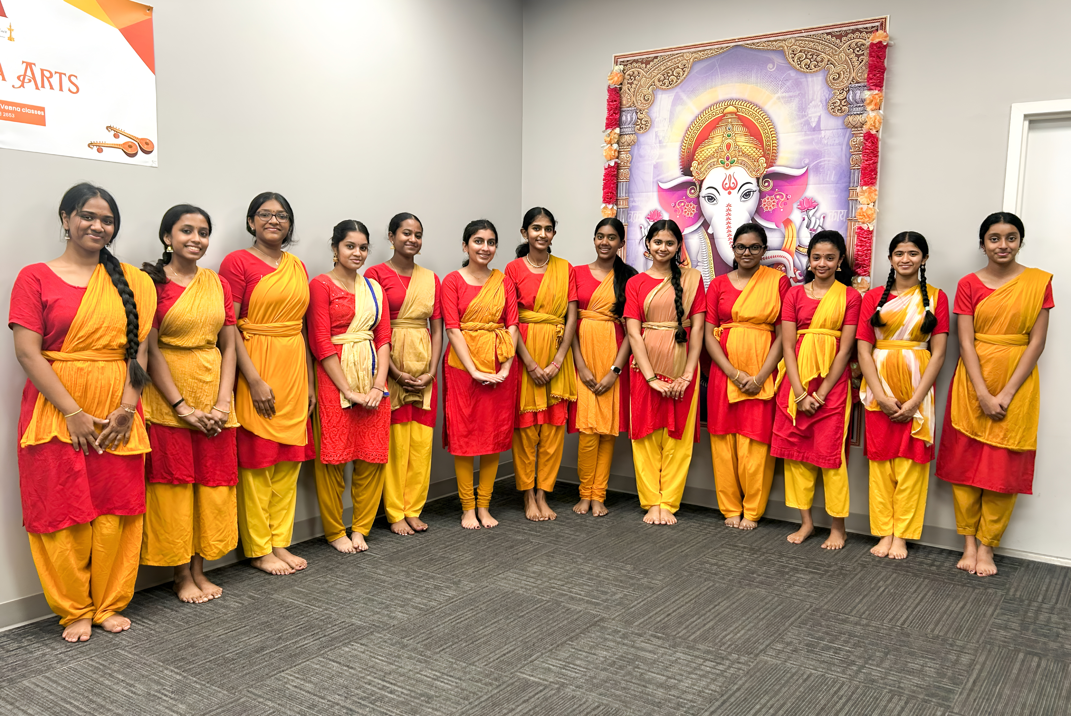
Aadhirai Sivabalan Deekshana Ramarajan Keerthana Bejoy Lakshana Rajeshkumar Lakshya Prabhu Karthick Prabhu Lohita Kani Maria Maliakal
Navya Prabhu Karthick Prabhu Sahana Vaithiyanathan Sankeerthana Pradeep Srinidhi Rajaraman Srinethe Sukesh Veda Biju Vyga Maheshkrishnan Nair
DK06
Notes:
Image: DK06.jpg

